Slide 1
Travel Training
Fall 2023

Slide 2
Agenda
Updates to State Travel Regulations
GSA Review
Common Forms
International Travel
Before Travel Overview
Creating a Spend Authorization
Post Travel Overview
Creating an Expense Report
Top Reasons Requests are Delayed
Top Reasons Requests are Reduced
Miscellaneous
Questions

Slide 3
State Travel Regulations
State Travel Policy
(PPM-49)
Includes state travel regulations
Controller’s Office & State Travel website for more information
Updates are sent through Faculty/Staff Notices

Slide 4
Travel Regulation Updates
Utilization of Uber/Lyft -If utilizing Uber or Lyft type services, only a standard size vehicle is reimbursable with an itemized receipt. Premium or larger vehicles are not reimbursable.
a. Uber Black, Uber Black XL, and Uber Premier are not reimbursable
b. Lyft Lux, Lyft Lux Black, and Lyft Lux Black XL are not reimbursable
Clarification on Conference Lodging - Travelers may be allowed the conference lodging rates, plus tax (other than Louisiana Sales Tax) and any mandatory surcharge. Receipts are required along with documentation showing the actual conference rate.
Enterprise Rates increased as of 9/15/23

Slide 5
What is the GSA System?
U.S. General Services Administration
Hotel Daily Rates & Meal Per Diems
Over 300 listed cities Nationwide
For meals and incidentals: First and Last Day are calculated at 75%
Per PPM49: Alaska, Hawaii, & U.S. Territories will follow:
Breakfast $18.00, Lunch $29.00, Dinner $47.00, & Incidentals $5.00
$200.00 Nightly Lodging
First and Last day meals and incidentals shall not exceed $74.25
GSA has increased the Standard/Other lodging rate to $107.00 nightly

Slide 6
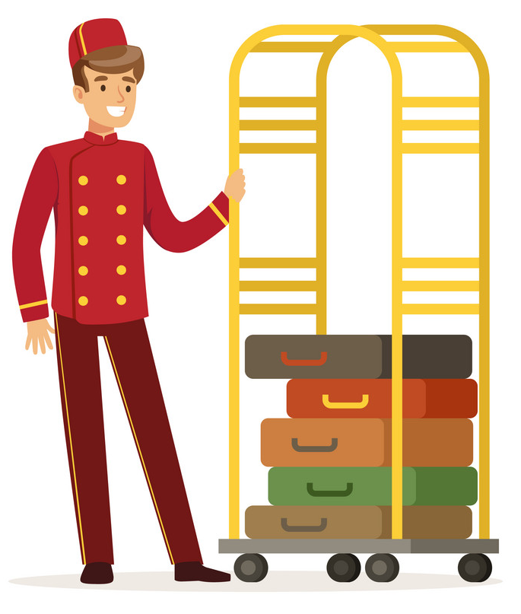
Incidentals – What are they?
Definition: Fees and Tips given to porters, baggage carriers, hotel staff, and other staff members.
Incidentals replaces the various Tips expense items in Workday.

Slide 7
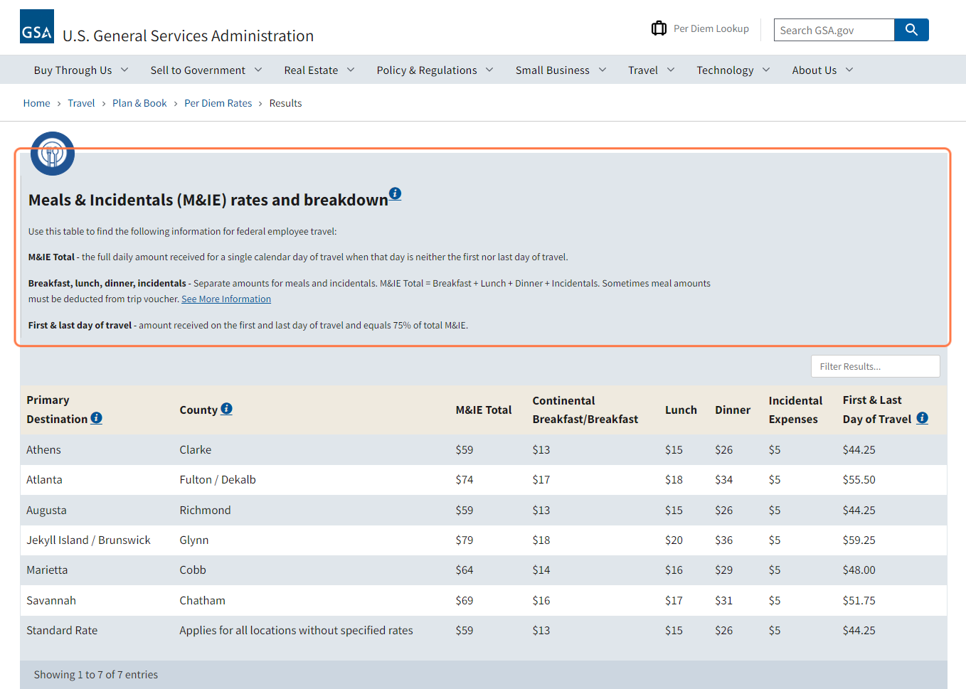
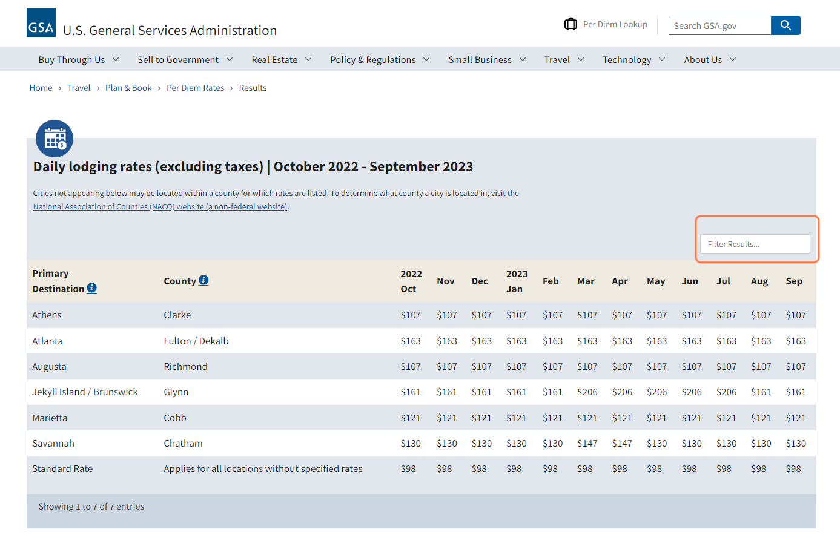
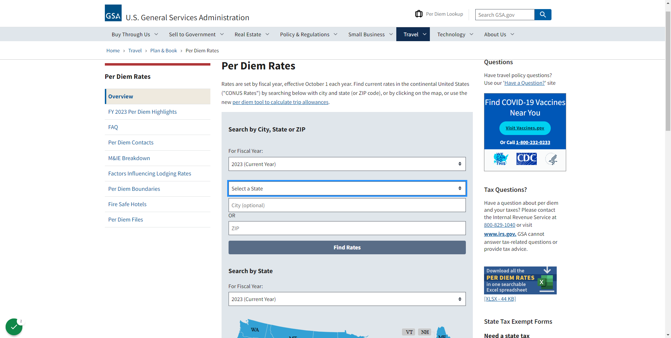
GSA System

Slide 8
Forms: Most Common
Travel Advance – Use when you are 1. requesting a Cash Advance related to Student Travel, or 2. requesting advanced reimbursement for expenses*
Hotel Overage – Use when the hotel will exceed the allowed nightly GSA rate, per-tax.
State Sales Tax Exemption – Use for In-State travel to remove State sales tax.

Slide 9
International Travel: A Brief Review
Use the ‘International’ version for the expense items and use ‘Travel-International’ in the Business Process
Uses the U.S. Department of State guide lines for nightly rate allowances and meal Per Diems
International travel use the individual Breakfast, Lunch, Dinner, and Incidentals expense lines
The $5.00 incidental is automatically given but every tier has an ‘up to’ amount for incidentals
Use OANDA for currency conversation

Slide 10
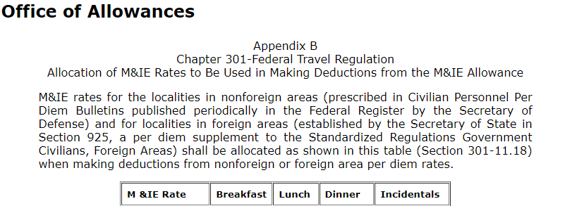
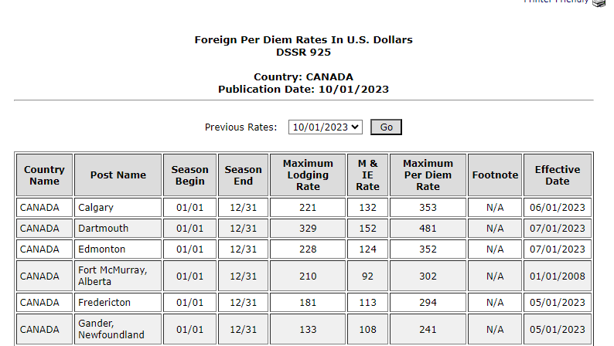
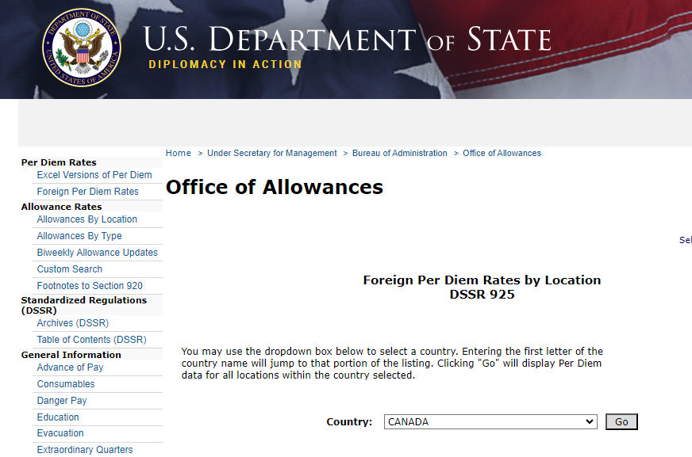
International Travel: A Brief Review

Slide 11
When do I need a Spend Authorization?
Going on a conference
whether it’s In or Out of State
Seeking reimbursement for mileage
Traveling with students
Doing any type of travel outside of your routine work activity

Slide 12
Before Travel Checklist
Before you Travel
Create a Spend Authorization
Spend Authorization is Approved

Slide 13
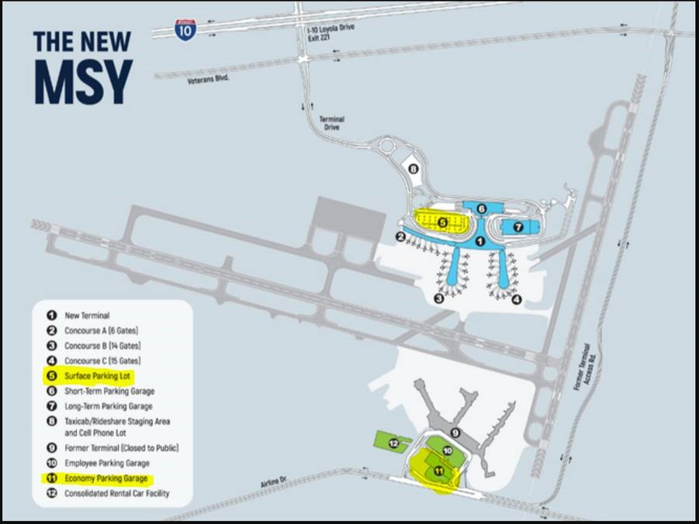
Before Travel-Flights
Book flights through Christopherson Business Travel.
New Orleans Airport Parking:
US PARK Uncovered Lot (bring your university photo ID for discount), MSY Surface Lot, and MSY Economy Garage.
Baton Rouge Airport Parking:
Bring your university photo ID and Airport Certificate for discount.

Slide 14
STATE CONTRACTED TRAVEL AGENCY
CHRISTOPHERSON BUSINESS TRAVEL
WEBSITE: HTTPS://APP.CBTAT.COM/
TOLL FREE: 800-535-0179
EMAIL: ONLINESUPPORT@CBTRAVEL.COM
NON-REFUNDABLE ONLINE BOOKING TRANSACTION FEE
$7 FOR DOMESTIC OR INTERNATIONAL TICKET
TRAVEL ADVISOR TEAM
TOLL FREE: 800-961-0720
EMAIL: STATELAUNIV@CBTRAVEL.COM
NON-REFUNDABLE AGENT TRANSACTION FEES-
$24.00 PER DOMESTIC TICKET
$31.00 PER INTERNATIONAL TICKET
Christopherson Business Travel
5588 S. Green Street
Salt Lake City, UT 84123

Slide 15
Before Travel-Driving
Are you Driving?
Less than 99 miles
Use personal vehicle and claim $0.655/mile
Provide Google Map or Map Quest PDF
More than 99 Miles
Spend Authorization & Vehicle Rental Form
For rental vehicles, fuel receipts are to be original and itemized
Traveling out of state: attach airfare quote to show cost savings

Slide 16
Before Travel-Hotels
Louisiana Travel
Hotel Tax Exemption Form & GSA Rate
Conference Hotel
Hotel Overage Request Form
Sharing a room?
Allowable Rate (x) People in Room

Slide 17
Before Travel- Miscellaneous
Miscellaneous Items
Registration Fees
PCARD or personal card with reimbursement
Membership Fees
Cannot reimburse through Travel
LA State Sales Tax
Usually not reimbursed
Tax Exemption Form

Slide 18
Before Travel - Miscellaneous
Must be an authorized traveler
Acknowledgement of Non-State Employees Utilizing State Vehicles form
No reimbursement without Safety Driving Course

Slide 19
Travel Advance vs. Cash Advance
Only used when you are traveling WITH students
Use when you are seeking advanced reimbursement for airfare
Cash Advance
Vs.
Travel Advance

Slide 20
During Travel - Reminder
KEEP ALL
RECEIPTS!
Notes:
PLEASE DO NOT TAPE OVER ANY WORDS, THEY WILL FADE
DO NOT STAPLE RECEIPT
PLEASE INDCATE WHO/WHAT EXP RECEIPT ARE FOR

Slide 21
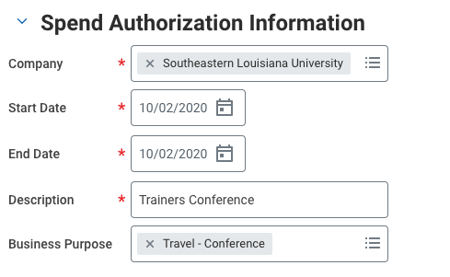
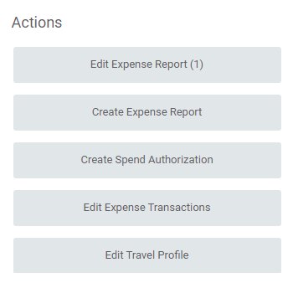
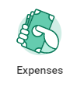
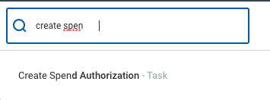
How To Create a Spend Authorization

Slide 22
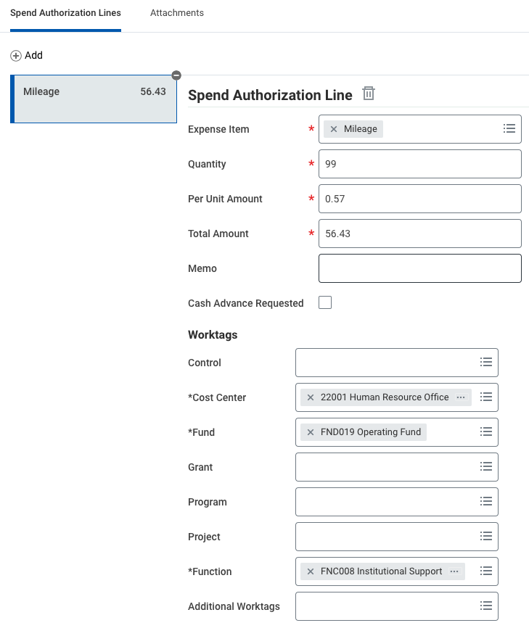
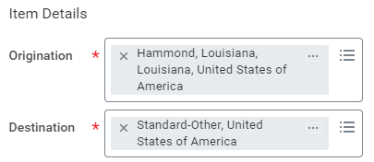
Spend Authorization
Only cities listed by the GSA are available to choose, except Hammond, LA. If your destination city is not listed, choose “Standard-Other” and enter the specific city name in the Memo section.

Slide 23
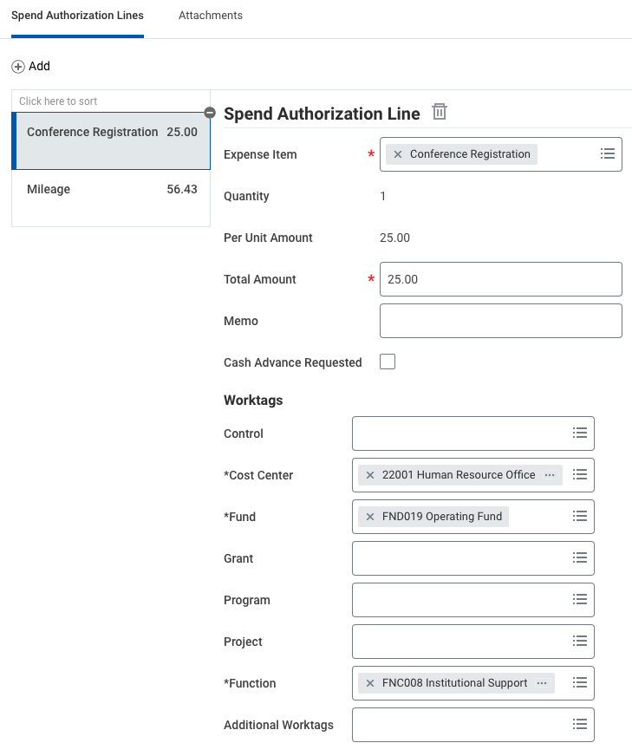
Spend Authorization
Notes:
Make note of your assigned spend authorization number for future reference and tracking.

Slide 24
Spend Authorization- Meals & Incidentals
Notes:
Be careful to select the correct “Meals & Incidentals Expenses – Per Diem” line item for the type of transaction you are working on (i.e. Spend Authorization vs. Expense Report).

Slide 25
Spend Authorization- Reminders
All forms have been sent for approval
Attachments have been uploaded
Submitted in Workday

Slide 26
Post - Travel
Complete Expense Report in Workday
Itemize expense based on type
Each traveler seeking reimbursement needs an expense report
Upload conference agenda
Submit original receipts and forms

Slide 27
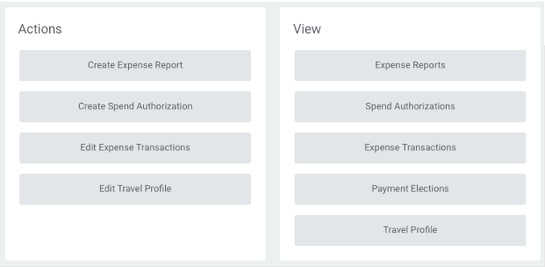
Create Expense Report
OR

Slide 28
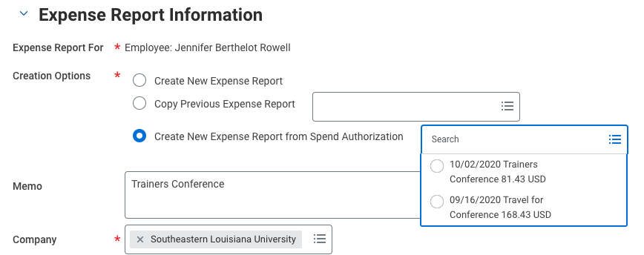
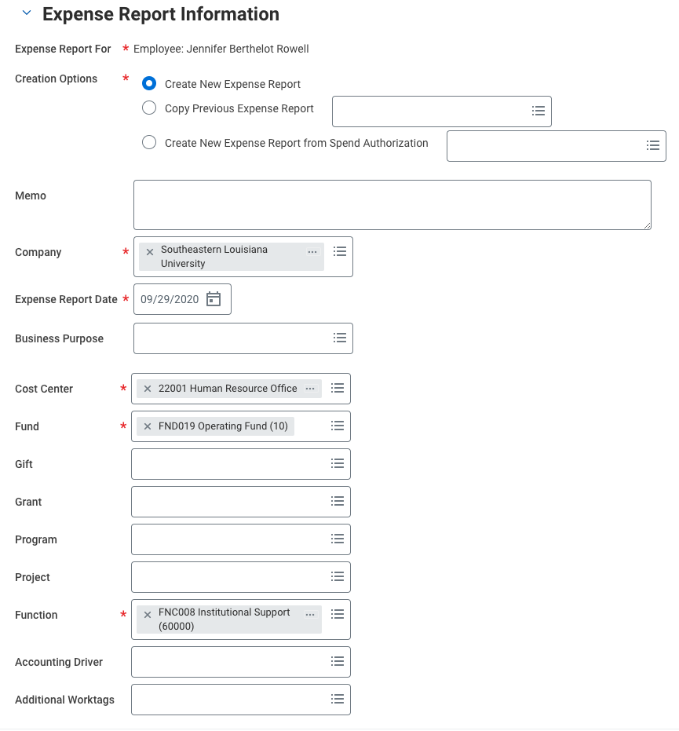
Create Expense Report
Select the Create New Expense Report option when starting from scratch.
Select the Create New Expense Report from Spend Authorization when filing for reimbursement expenses from travel related to an approved Spend Authorization.

Slide 29
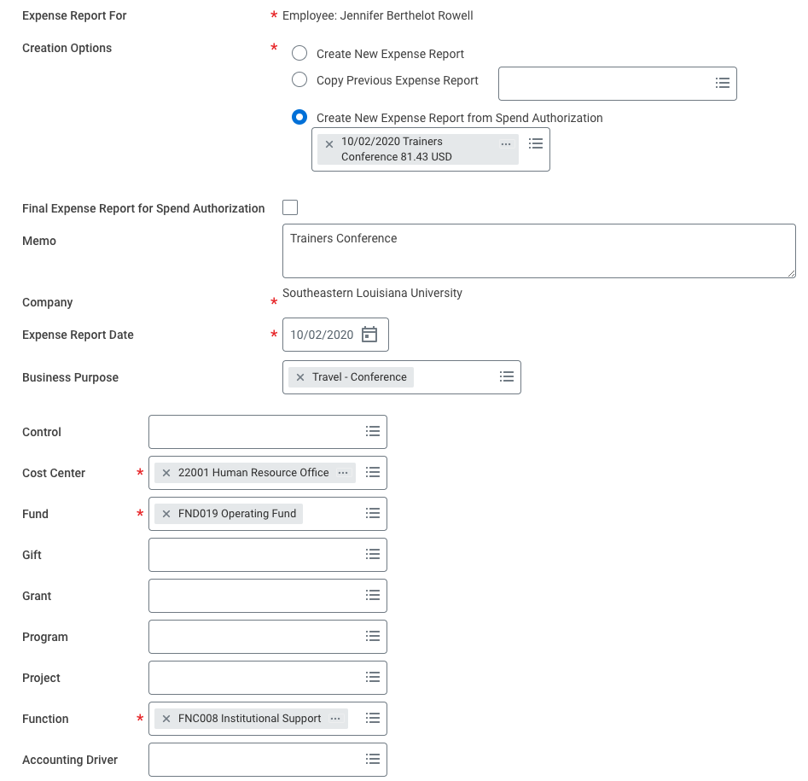
Create Expense Report

Slide 30
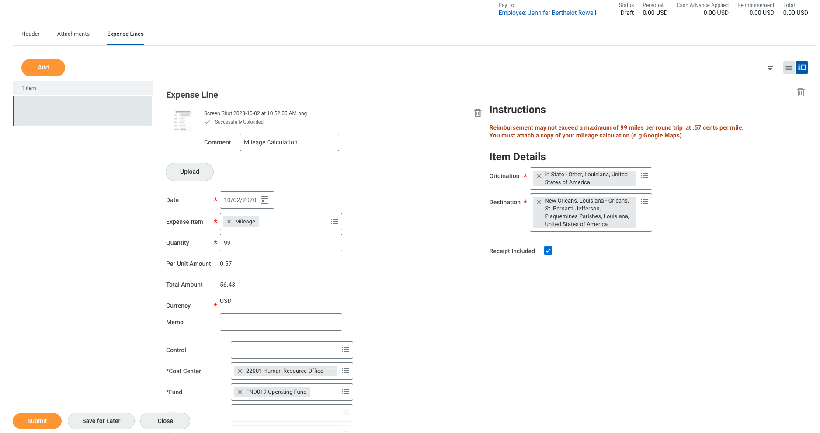
Create Expense Report
This is what a newly created expense report will look like before all expense lines are added. Each expense item type that is being requested for reimbursement will need to be added.

Slide 31
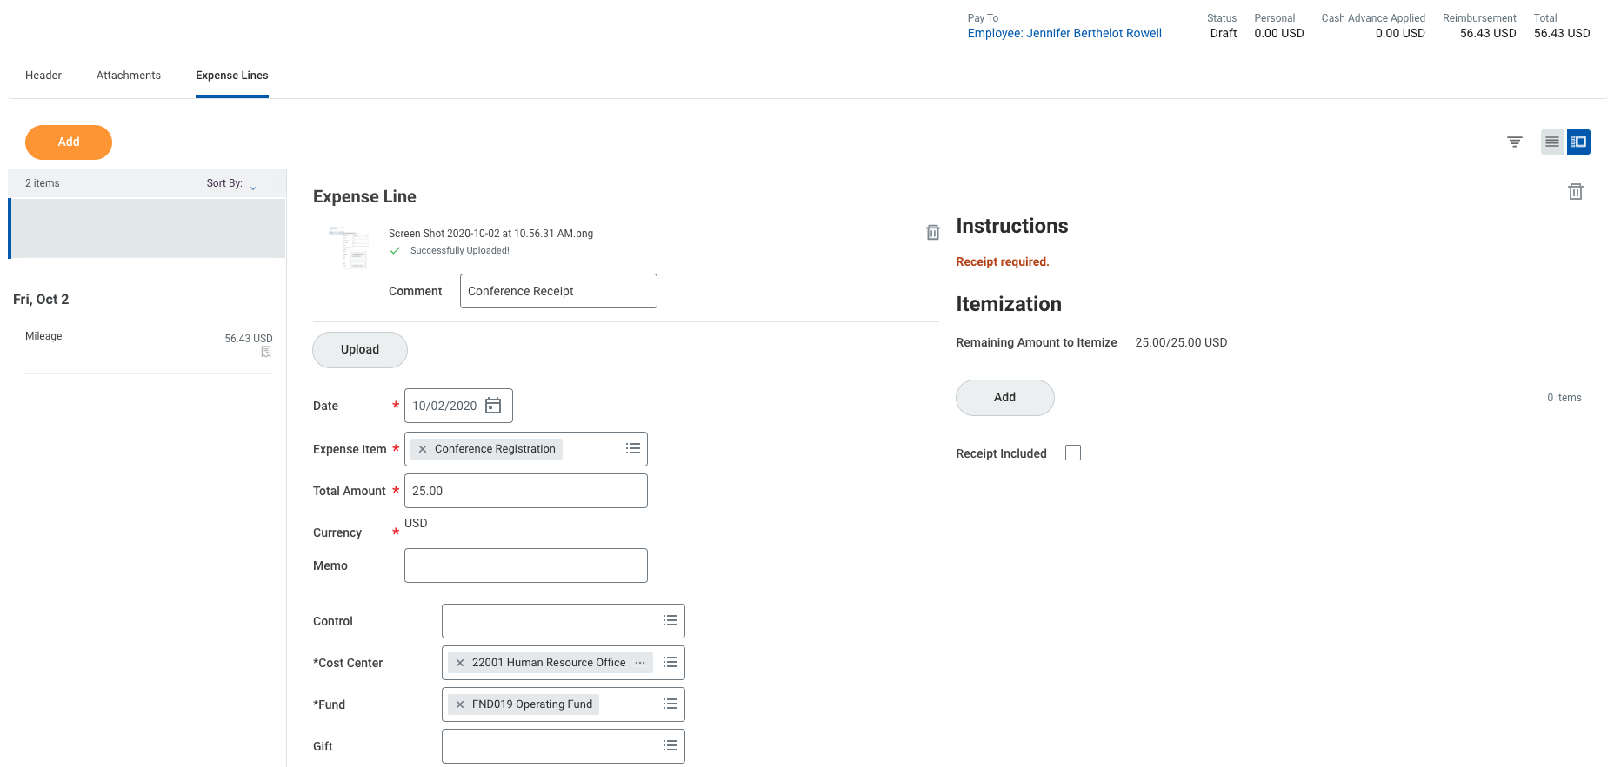
Create Expense Report

Slide 32
Expense Reports - Meals & Incidentals

Slide 33
Expense Reports - Reminders
All forms have been approved
Attachments have been uploaded
Submitted to the Travel Office

Slide 34
Top Reasons Travel Reimbursements are Delayed
Expense Reports not submitted timely
Should be submitted within 5 days of travel completion.
Spend Authorizations not fully Approved
Forms are submitted for approval after travel is completed
Original receipt not Submitted to Travel Office timely
If sent via campus mail; may be delayed by 3-5 days; hand delivering is best.
Proper documentation not uploaded
Should be submitted and approved prior to travel.
Should be submitted and approved prior to travel.
Ensure all receipts, agenda, maps, forms, etc. are attached to expense report.

Slide 35
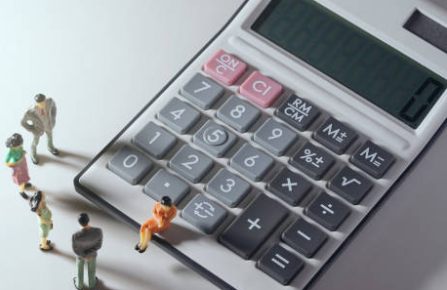
Top Reasons Travel Reimbursements are Reduced
Hotel Rates Exceed Allowed GSA Rate
No Original Receipt Provided
Louisiana State Sales Tax Charged
Tips Exceed 20%
Conference Provided the Requested Meals
Alcohol is NOT Reimbursable
State Contracted Airport Parking Lots Not Utilized

Slide 36
Miscellaneous Travel Notes/Tips
Do not book hotels through 3rd party sites
Get an itemized receipt when available
There are two expense items for Meals & Incidentals
In/Out-of-State-Other is replaced with Standard-Other
Hammond, LA is categorized as Standard/Other by the GSA
Always start the Spend Authorization prior to paying for the Conference Registration
Check on the status often and read all comments made if it was Sent Back.

Slide 37
All travel information, including policies, forms, and updates are located at:
www.southeastern.edu/travel
Travel Desk
Email: travel@southeastern.edu
Phone Number: 985-549-2089
Location: Accounts Payable Office, Room A103 of North Campus Main Annex
Mail: SLU Box 10720

