Slide 1
2021 Travel Training
Spring 2021

Slide 2
Agenda
State Travel Regulations
Travel Checklist Overview
Creating a Spend Authorization
Creating an Expense Report
Top Reasons Requests are Reduced
Top Reasons Requests are Delayed
Controller’s Office: Travel Website
Questions

Slide 3
State Travel Regulations
State Travel Policy
(PPM-49)
Packet includes state travel regulations through January 2021
Controller’s Office website for more information
Updates are sent through Faculty/Staff Notices

Slide 4
Before Travel Checklist Breakdown
Before you Travel!
Create a Spend Authorization
Spend Authorization is Approved

Slide 5
Before Travel Checklist Breakdown - Flights
Book through Christopherson Business Travel HTTPS://APP.CBTAT.COM
From New Orleans – reserve parking at WWW.USPARK.NET
From Baton Rouge, bring your State ID and Airport Certificate for discount.

Slide 6
Before Travel Checklist Breakdown - Flights
CONTRACTED TRAVEL AGENCY
EFFECTIVE JANUARY 1, 2021
CHRISTOPHERSON BUSINESS TRAVEL
WEBSITE: HTTPS://APP.CBTAT.COM/
ONLINE SUPPORT
TOLL FREE: 800-535-0179
EMAIL: ONLINESUPPORT@CBTRAVEL.COM
NON REFUNDABLE ON-LINE BOOKING TRANSACTION FEE:
$7 FOR DOMESTIC OR INTERNATIONAL TICKET
TRAVEL ADVISOR TEAM
TOLL FREE: 800-961-0720
EMAIL: STATELAUNIV@CBTRAVEL.COM
NON REFUNDABLE AGENT TRANSACTION FEES:
$24.00 PER DOMESTIC TICKET
$31.00 PER INTERNATIONAL TICKET
Christopherson Business Travel
5588 S. Green Street
Salt Lake City, UT 84123

Slide 7
Before Travel Checklist Breakdown - Driving
Are you Driving?
Less than 99 miles
Use personal vehicle and claim $0.56/mile
Provide odometer and online map calculator
More than 99 Miles
Vehicle Rental Form; State Acct Number: L142174
Gas receipts to be original and itemized
Traveling out of state, attach airfare quote to show cost savings

Slide 8
Before Travel Checklist Breakdown
Must be an authorized traveler
Acknowledgement of Non-State Employees Utilizing State Vehicles form
No reimbursement without Safety Driving Course

Slide 9
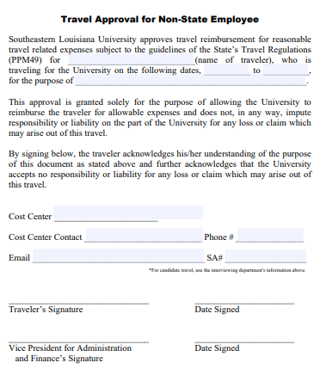
Before Travel Checklist Breakdown
Must turn in original to Travel Desk after FULLY approved.

Slide 10
Before Travel Checklist Breakdown: Hotels
Check travel destination on state’s tier system.
Louisiana Travel: Hotel Tax Exemption Form
Out of State Travel: Hotel Overage Request Form
Other Travel: limited to state rate
Sharing a room? Allowable rate: state rate x people in room

Slide 11
Before Travel Checklist Breakdown: Misc.
Miscellaneous Items
Registration Fees
PCARD or personal card with reimbursement
Membership Fees
Cannot reimburse through Travel
Travel/Cash Advances
When spending personal funds on airfare or registration
Travel Advance Agreement/Request
LA State Sales Tax
Usually not reimbursed
Tax Exemption Form

Slide 12
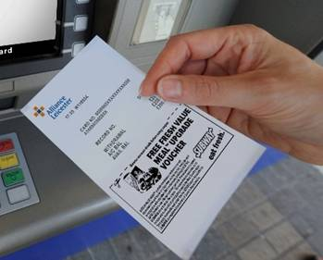
Before Travel Checklist Breakdown
KEEP ALL
RECEIPTS!

Slide 13
After Travel Checklist Breakdown
Complete Expense Report in Workday
Itemize expense based on type
Each traveler needs an expense report
Upload conference agenda
Submit original receipts and forms
Jamie Grady
Within 5 days of travel
Travel Desk @ SLU 10720

Slide 14
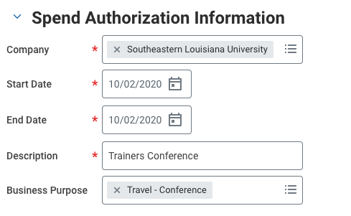
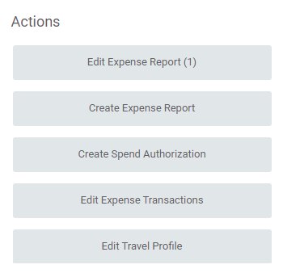
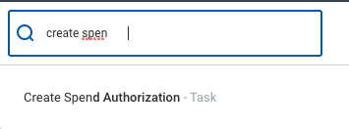
Spend Authorization
OR

Slide 15
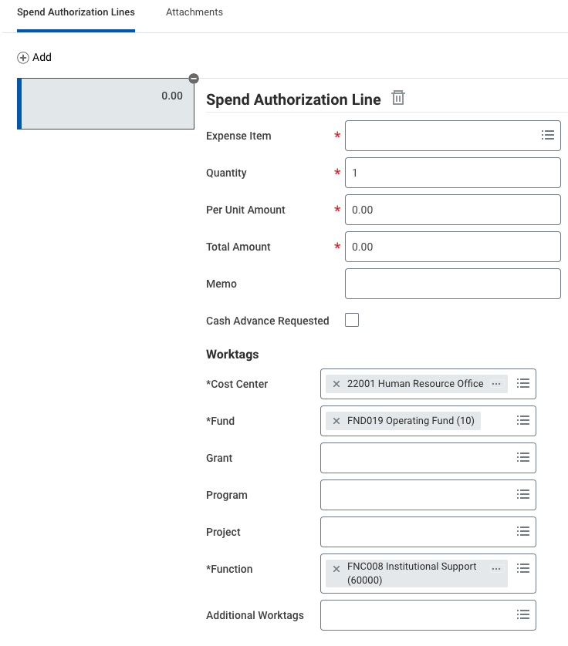
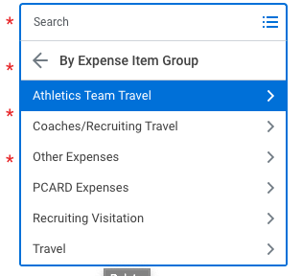
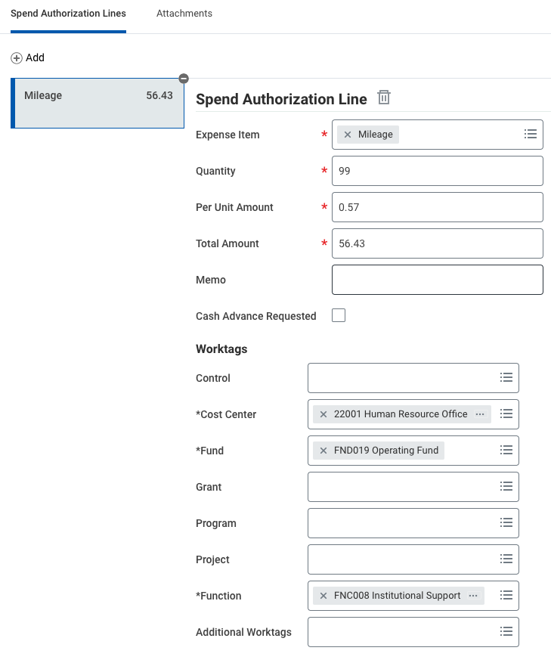
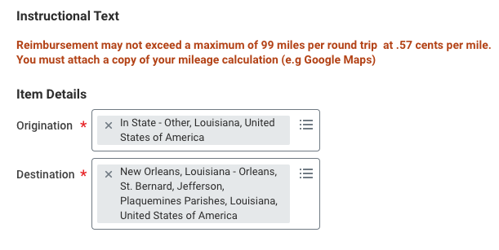
Spend Authorization
Only cities listed in PPM49 are available to choose, except Hammond. If your destination city is not listed, choose “Other” and list the city in the Memo box

Slide 16
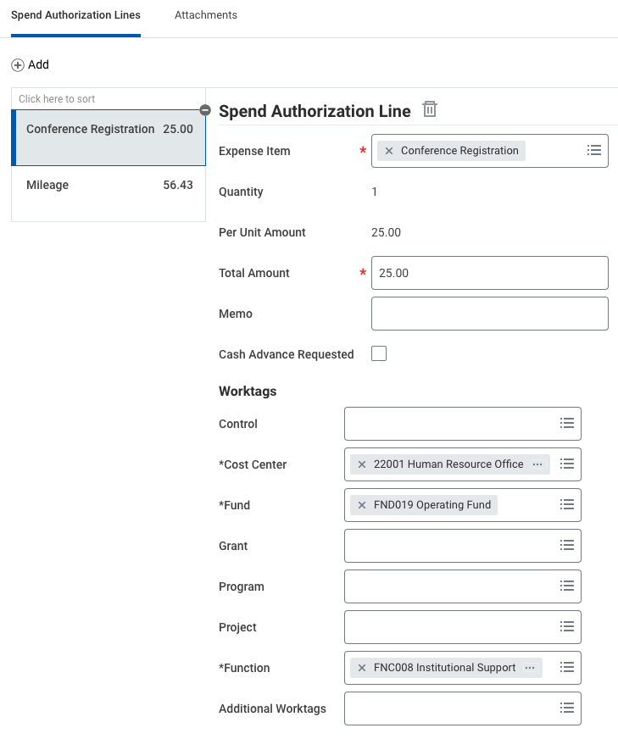
Spend Authorization

Slide 17
Spend Authorization
All forms have been approved
Attachments have been uploaded OR
Submitted to the Travel Office

Slide 18
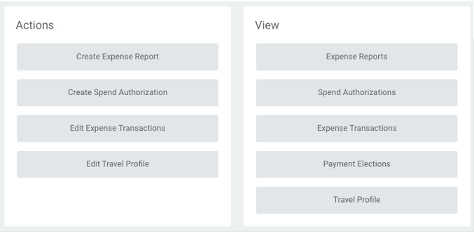
Expense Report
OR

Slide 19
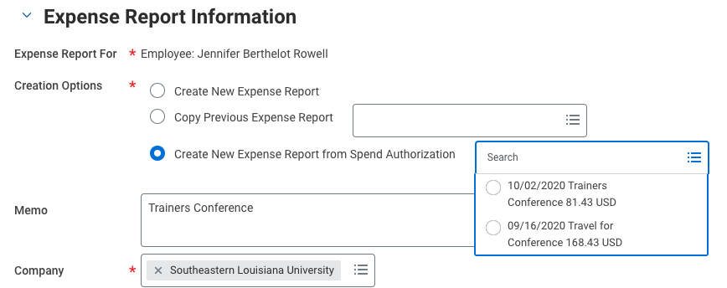
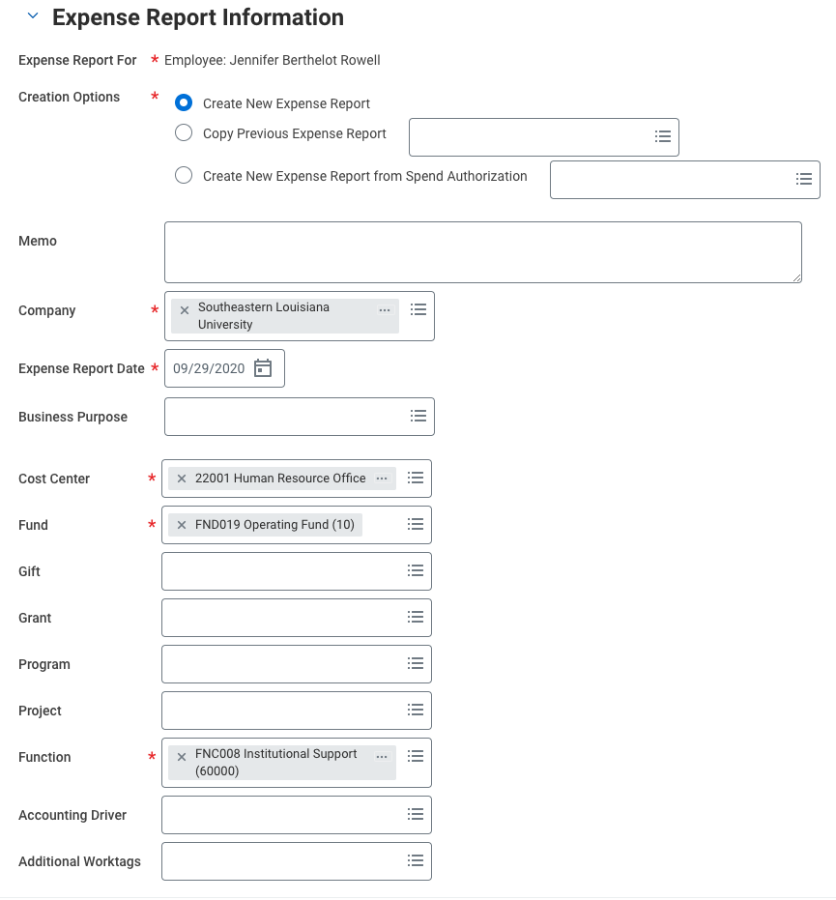
Expense Report
For Routine Field Travel, choose Create New Expense Report.
For all other travel with a previously approved Spend Authorization, choose Create New Expense Report from Spend Authorization drop down menu and choose the correct Spend Authorization associated with the expense report.

Slide 20
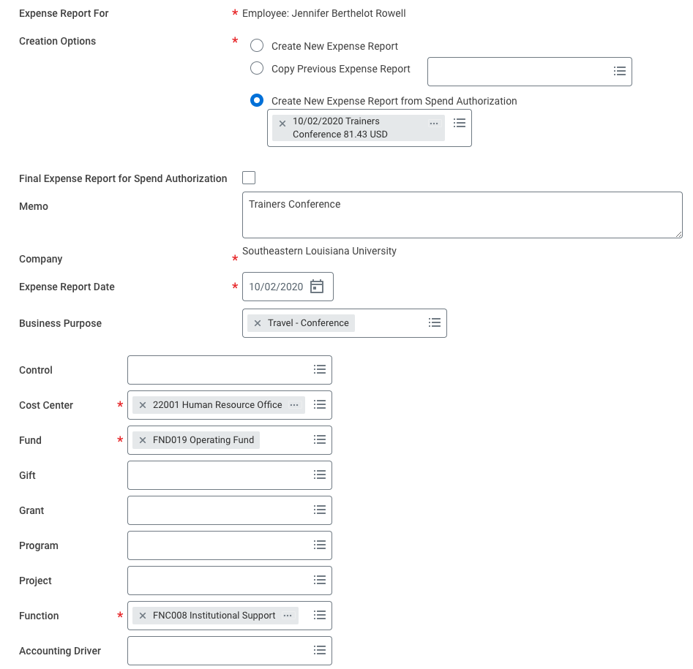
Expense Report

Slide 21
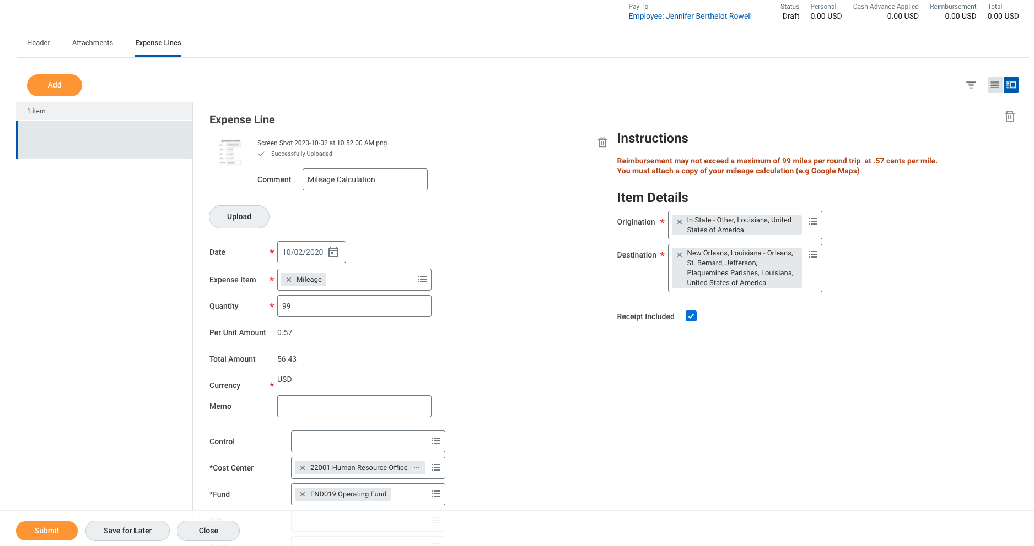
Expense Report

Slide 22
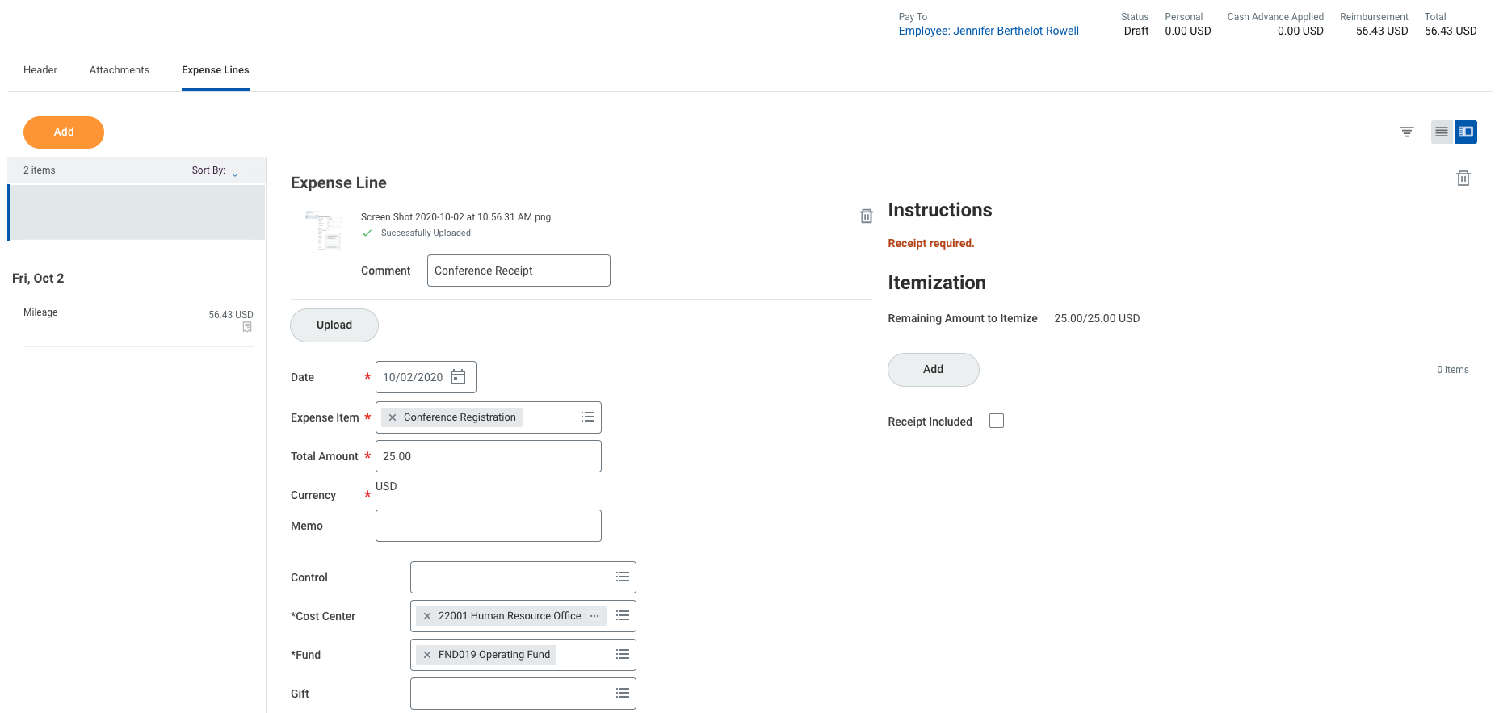
Expense Report

Slide 23
Expense Repport
All forms have been approved
Attachments have been uploaded OR
Submitted to the Travel Office

Slide 24
Top Reasons Travel Requests are Reduced
Hotel Rates outside state approved rate
Original receipts
Louisiana State Sales Tax not removed
USPARK.NET not used
Alcohol not reimbursable
Tips over 20%
Traveling outside timeframe of allowable meals

Slide 25
Top Reasons Travel Requests are Delayed
Must be within 5 days of travel completion
Approval forms submitted after travel
Original receipts not submitted to Travel Office timely
Proper documentation not uploaded
Expense Reports not submitted timely
Expense dates all outside approved dates of travel

Slide 26
Travel Website
All travel information, including policies, forms, updates, etc. are located at:
WWW.SOUTHEASTERN.EDU/TRAVEL

Slide 27
Questions?
Travel Accountant:
Jamie Grady
Extension: 2089
jamie.grady@southeastern.edu

