Slide 1
Intro to Windows 10

Slide 2
Why windows 10?
Windows 10 is the latest Microsoft Operating System.
Is replacing Windows 7 on campus
Much more friendly than Windows 8
More Secure (wannacry virus)
Runs better (uses fewer resources)

Slide 3
What’s New in windows 10?
A few feature highlights
• Start menu
• Using tiles
• How to search
• Task view
• Virtual desktops
• Snap enhancements
• Quick access tools
Personalization and Settings
• A new look
• Personalize your lock screen
• Themes
• Desktop and Colors

Slide 4
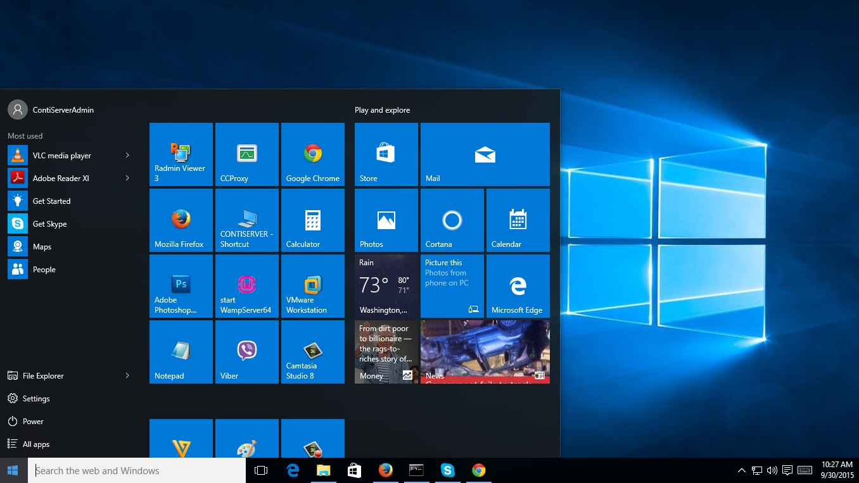
Start Menu
Windows 10:
Windows 7:

Slide 5
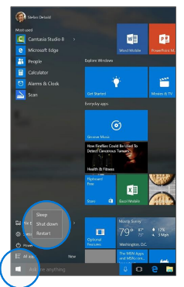
How to use the start menu:

Slide 6
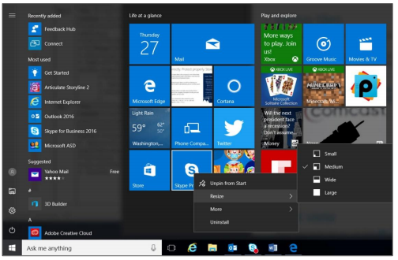
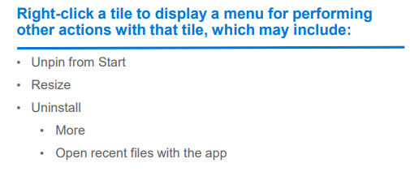
Start menu: Using tiles
In the right pane of the Start menu, you’ll find tiles for some common apps.
To move a tile, just drag it to another position. You can rearrange them within the pane. You can also drag apps between the tile view and the app list view.

Slide 7
How-to Search
Windows 10 Start menu comes with a great Search tool.
Search apps
Search files
Search the web
Use Cortana

Slide 8
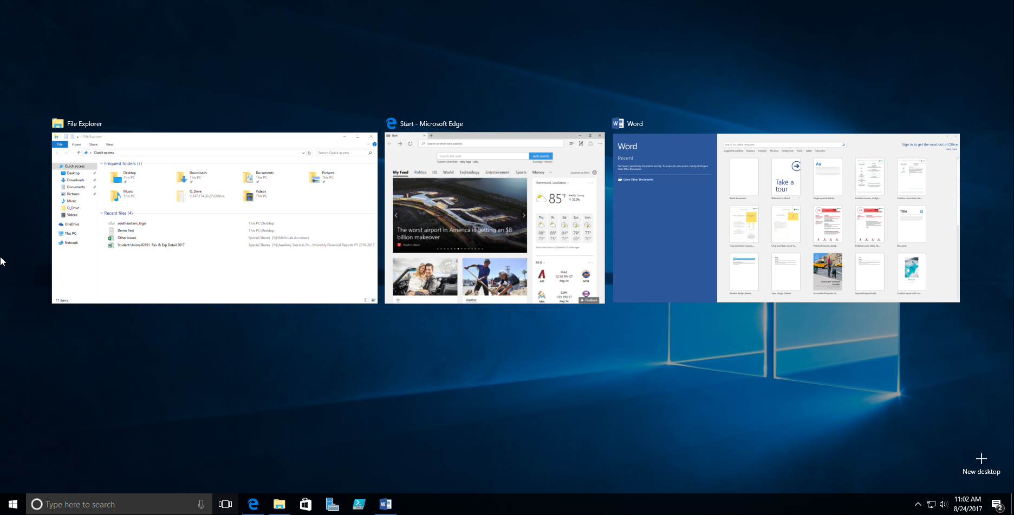
Task View
One of the best parts of windows.
Separate all apps into a spread out view to find the window you are looking for.
Great for organization!
Also “Windows + TAB”

Slide 9
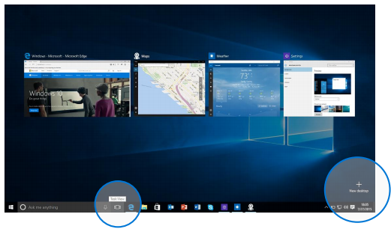
Virtual Desktops
Windows 10 adds support for virtual desktops, so you can keep your open apps better organized.
For example, if you need to work with spreadsheets, you could create a second virtual desktop that contains the apps/data you’re using.
Also can use “CTRL + Windows + arrow keys” to move between them.

Slide 10
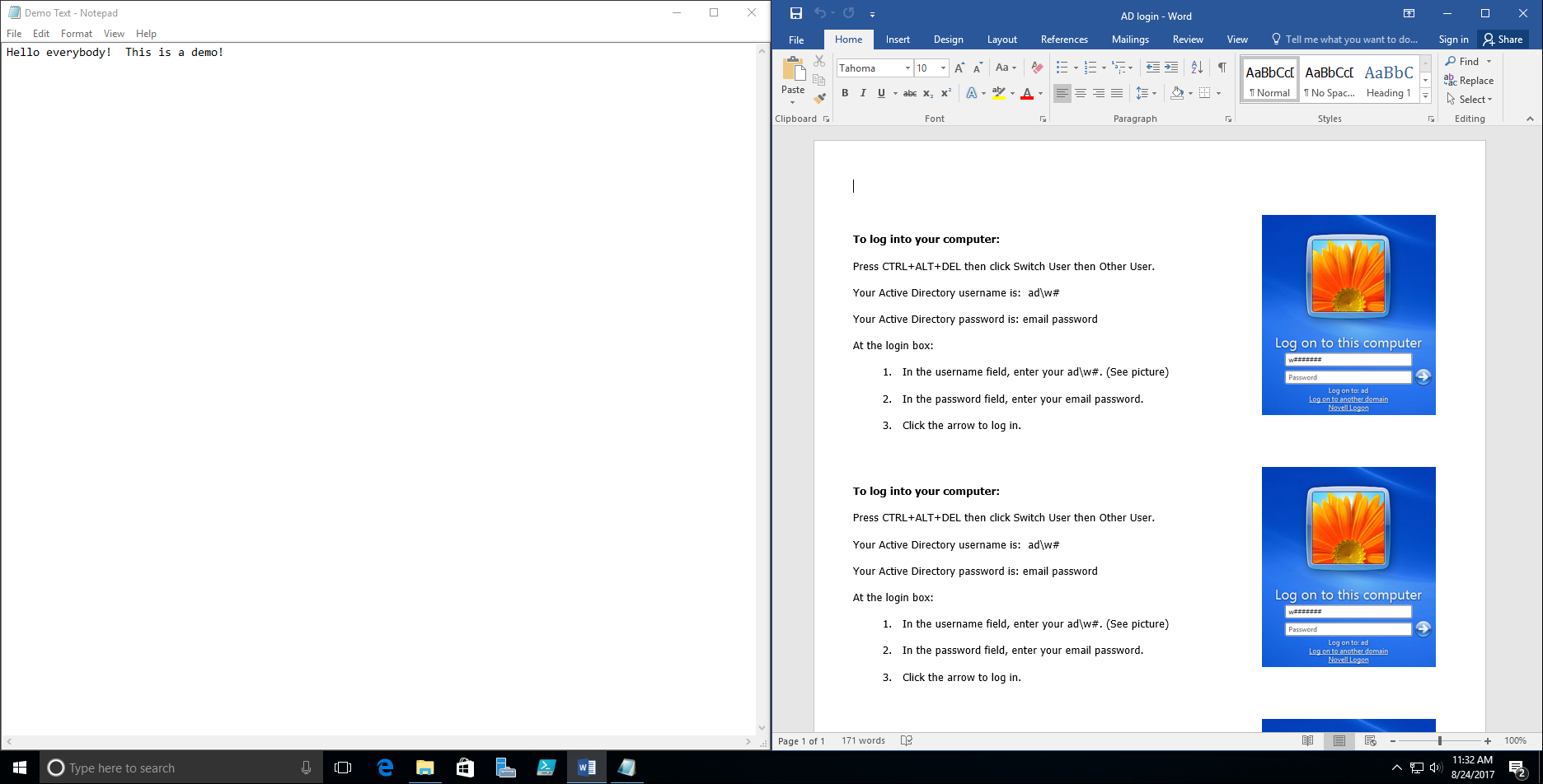
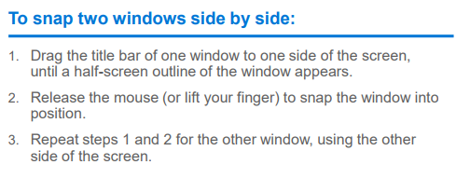
SnAp Enhancements
What are snap enhancements?
Split-screen view, up to four ways.

Slide 11
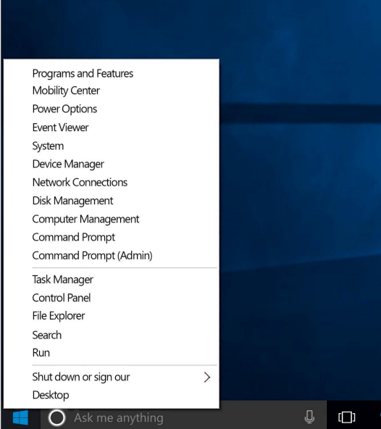
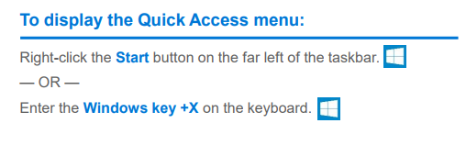
Quick Access Tools
The Quick Access menu provides access to advanced system tools such as Power Options, Task Manager, and Control Panel.

Slide 12
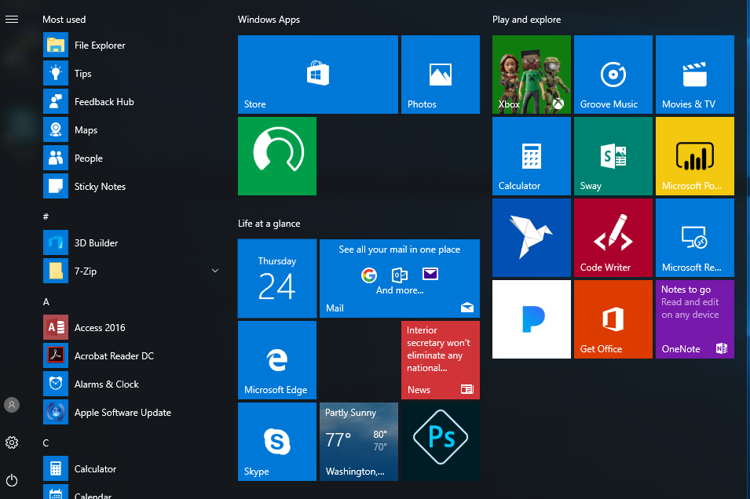
Personalization and Settings:
Settings gets a new “modern” look.
Basically, a condensed “control panel”
FYI, control panel is still available.

Slide 13
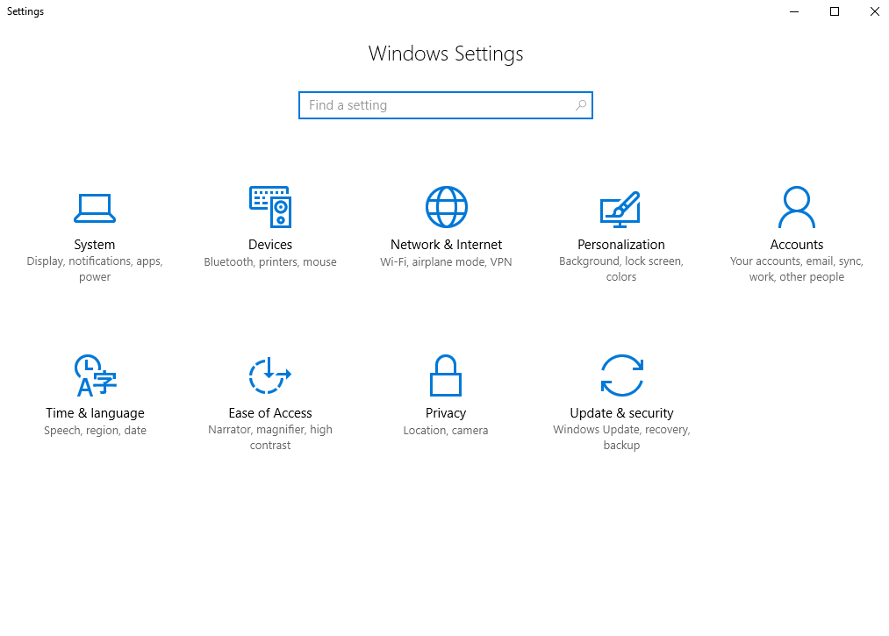
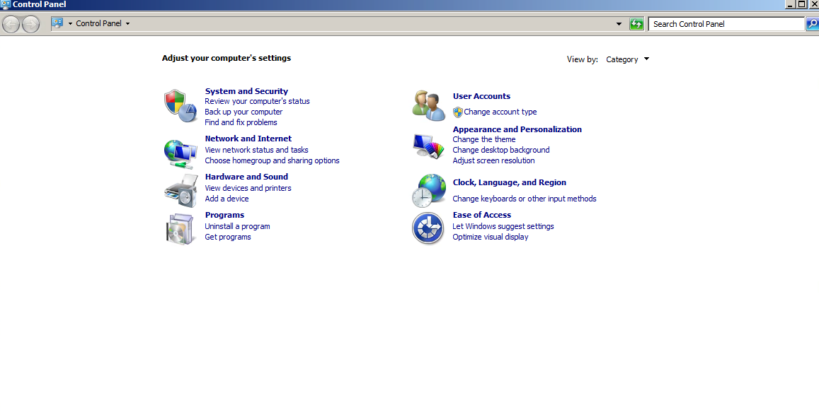
Settings in Windows 7 vs Windows 10
Windows 10:
Windows 7:

Slide 14
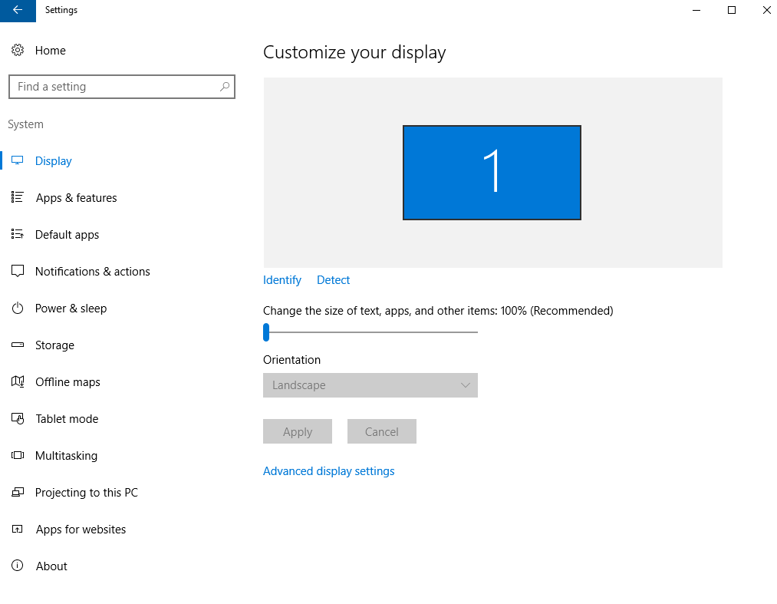
Settings for System
Settings here change system configurations (Display resolution/monitors, default apps, power, etc.)

Slide 15
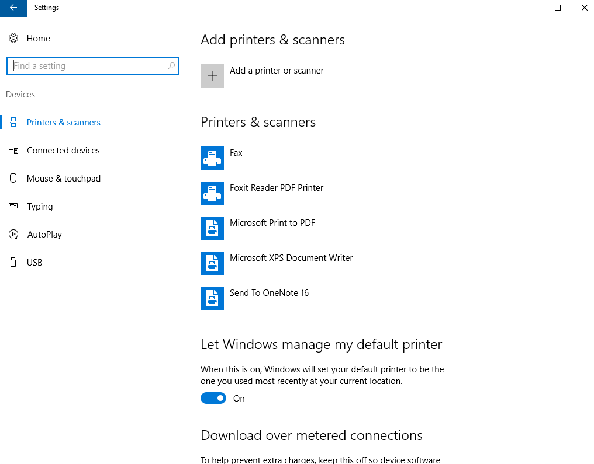
Settings for devices
Manage settings for external devices (printers, mice, scanners)
95% of time it’s printers
95% of time, use old view.

Slide 16
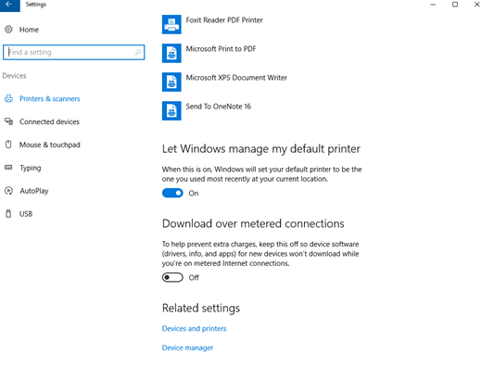
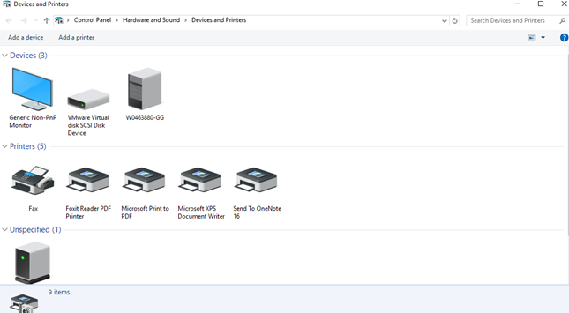
Settings for Devices (cont.)

Slide 17
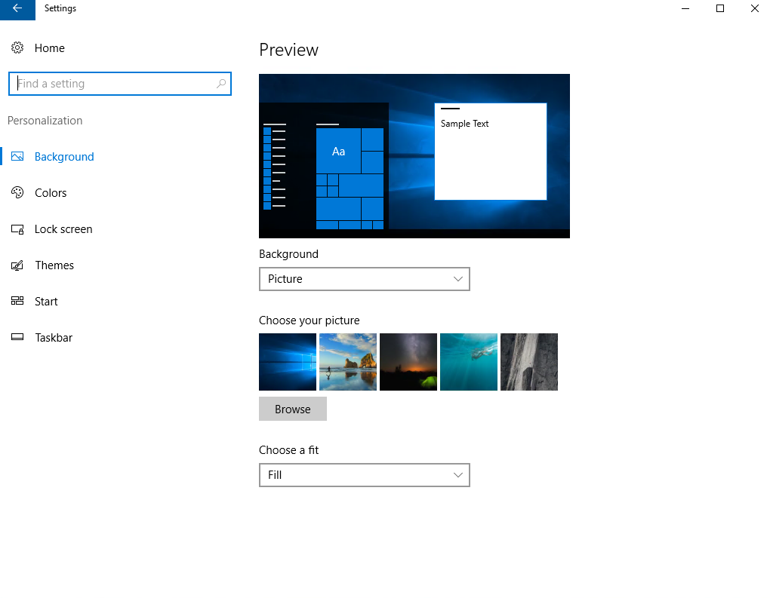
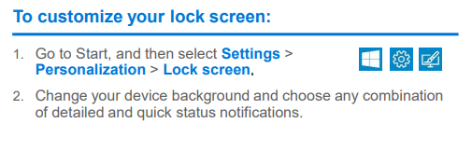
Personalization Settings
Tweak your lock screen to your liking. Change the background to a favorite photo or slide show, or show upcoming calendar events, social network updates, and other app and system notifications.

Slide 18
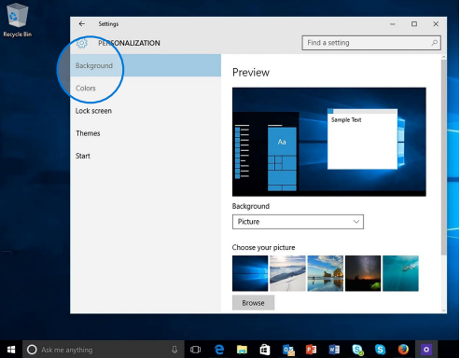
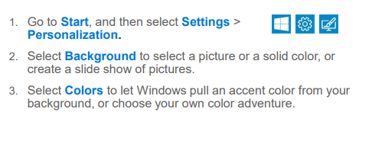
Personalization settings (cont.)
Choose a picture worthy of gracing your desktop background, and to change the accent color for Start, the taskbar, and other items. The preview window gives you a sneak peek of your changes as you make them.

Slide 19
Common Questions

Slide 20
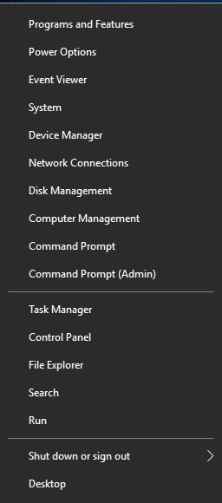
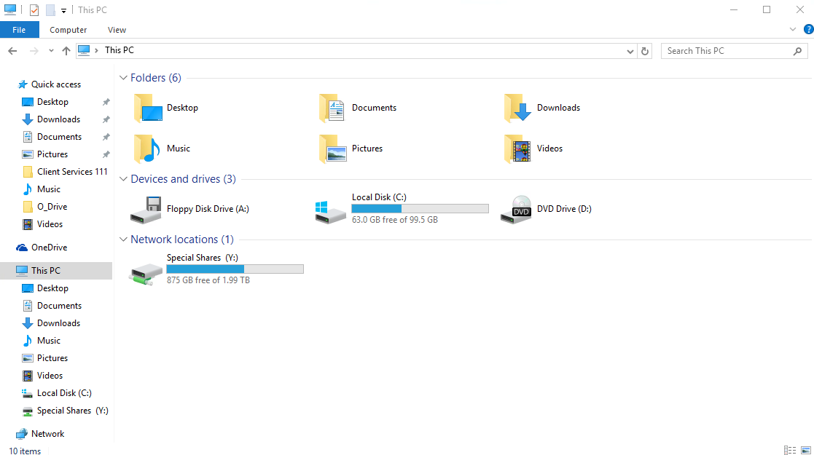
Where is “My Computer”?
Right-click the start button > Select File Explorer
Click “This PC” to get to your drives.

Slide 21
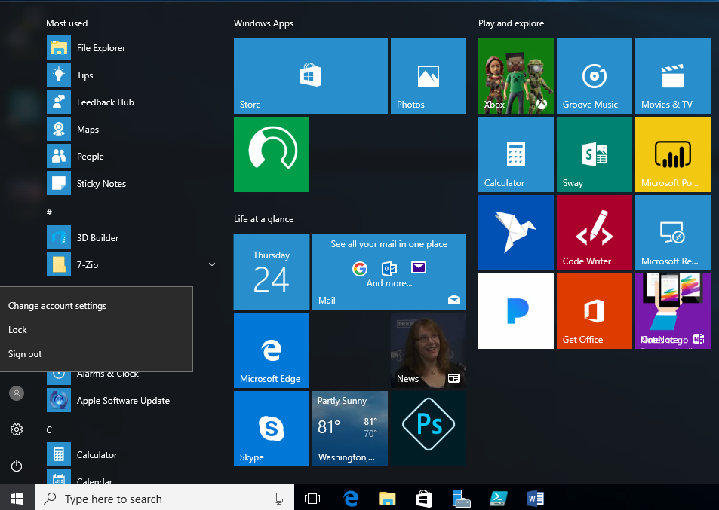
How do I “logout”?
Click the start button
Click the user icon
Select sign out.

Slide 22
How do I “switch users”?
Common when you need to login on someone else’s PC.
Select “other user” on login screen.
Sign in with AD information.

Slide 23
Adding Shortcuts to desktop
Click the Start button
Scroll to the app you want
Hold down the left mouse button
Drag the app to the desktop

Slide 24
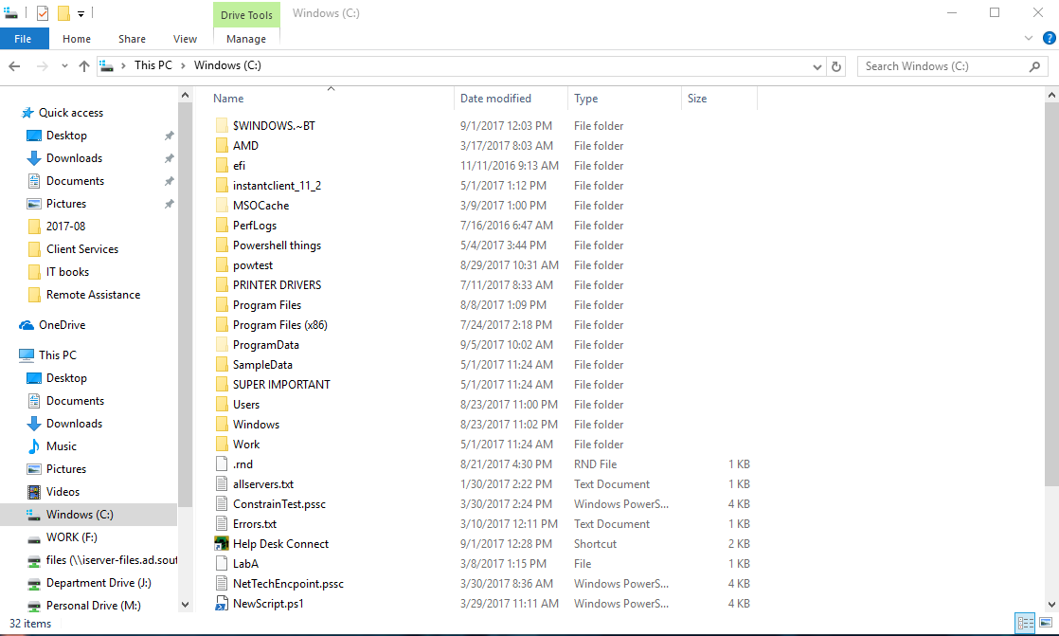
What is Helpdesk Connect?
A replacement for VNC (allows us to remote to your PC)
Go to C:\ drive.
File Explorer
This PC
Windows C:\
Click “Helpdesk Connect”
Only works when logging in with W#.

Slide 25
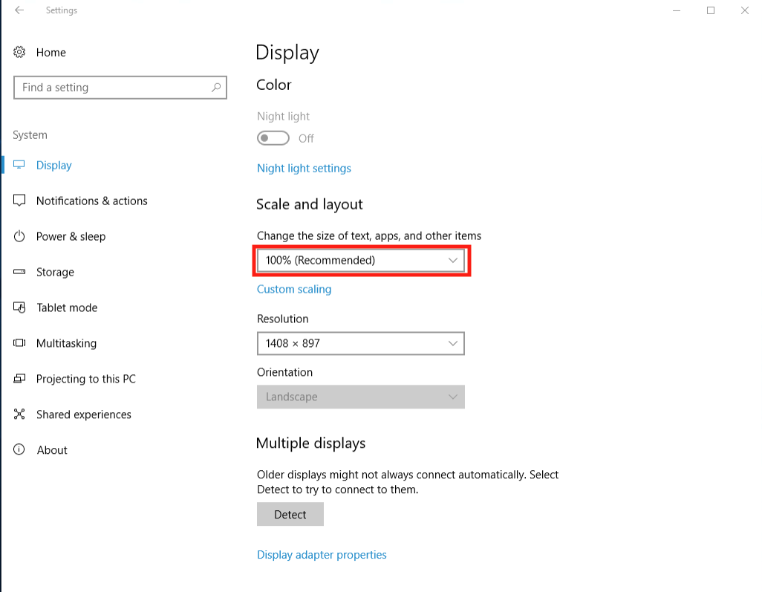
Why is everything hard to see?
Display options are allowed in all versions of Windows.
Under Settings > System > Display
Choose “Scale and Layout”
The dropdown allows you to enlarge text, apps, and other items.

Slide 26
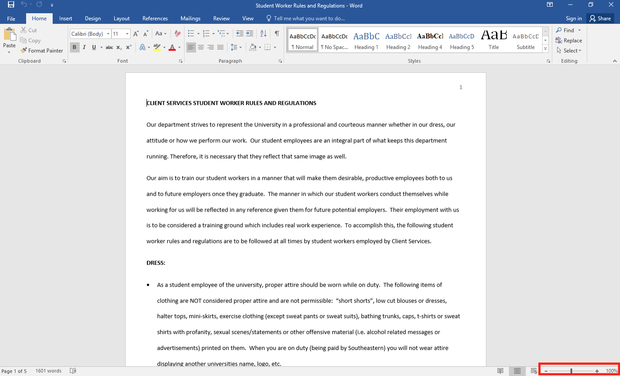
Why is everything hard to see? (pt. 2)
In common apps such as Microsoft Word, there is a way to increase the size of the document, without formatting the document itself.
The “View Slider” in the bottom right-hand corner allows a user to increase/decrease the magnification of a document.

Slide 27
Questions??
Any questions?

